Slide 1


Slide 2


About
Cognitive simulation game
Developed primarily for the mobile Android platforms

Slide 3
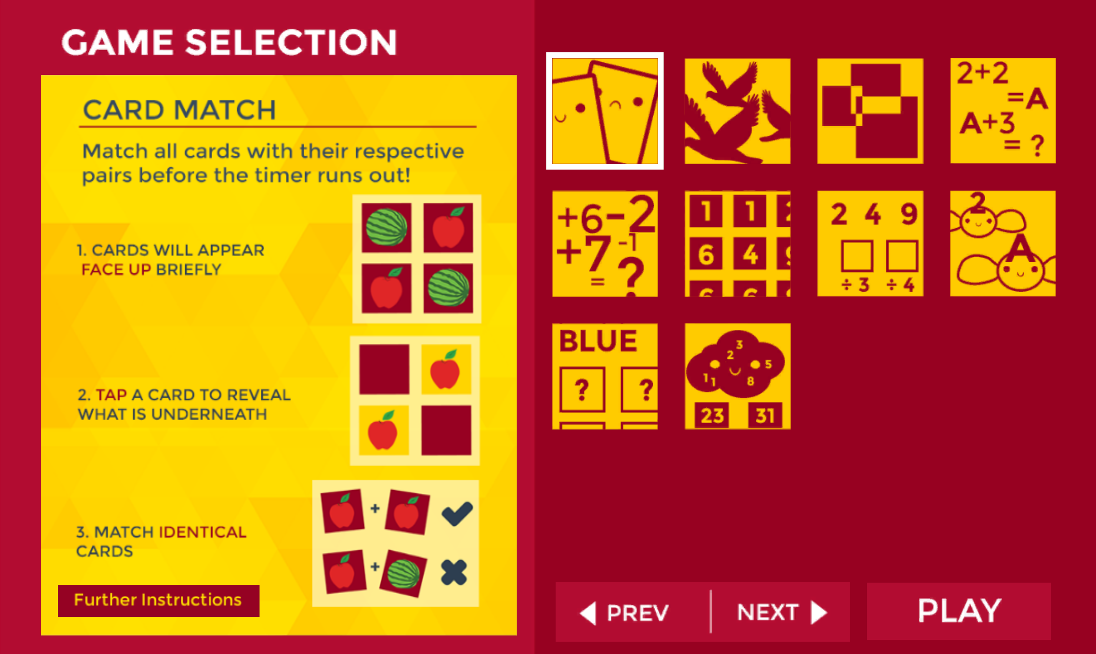
Overview
Present version has 10 mini-games
Each mini-game focuses on a different component of cognitive simulation
Can be played independently

Slide 4
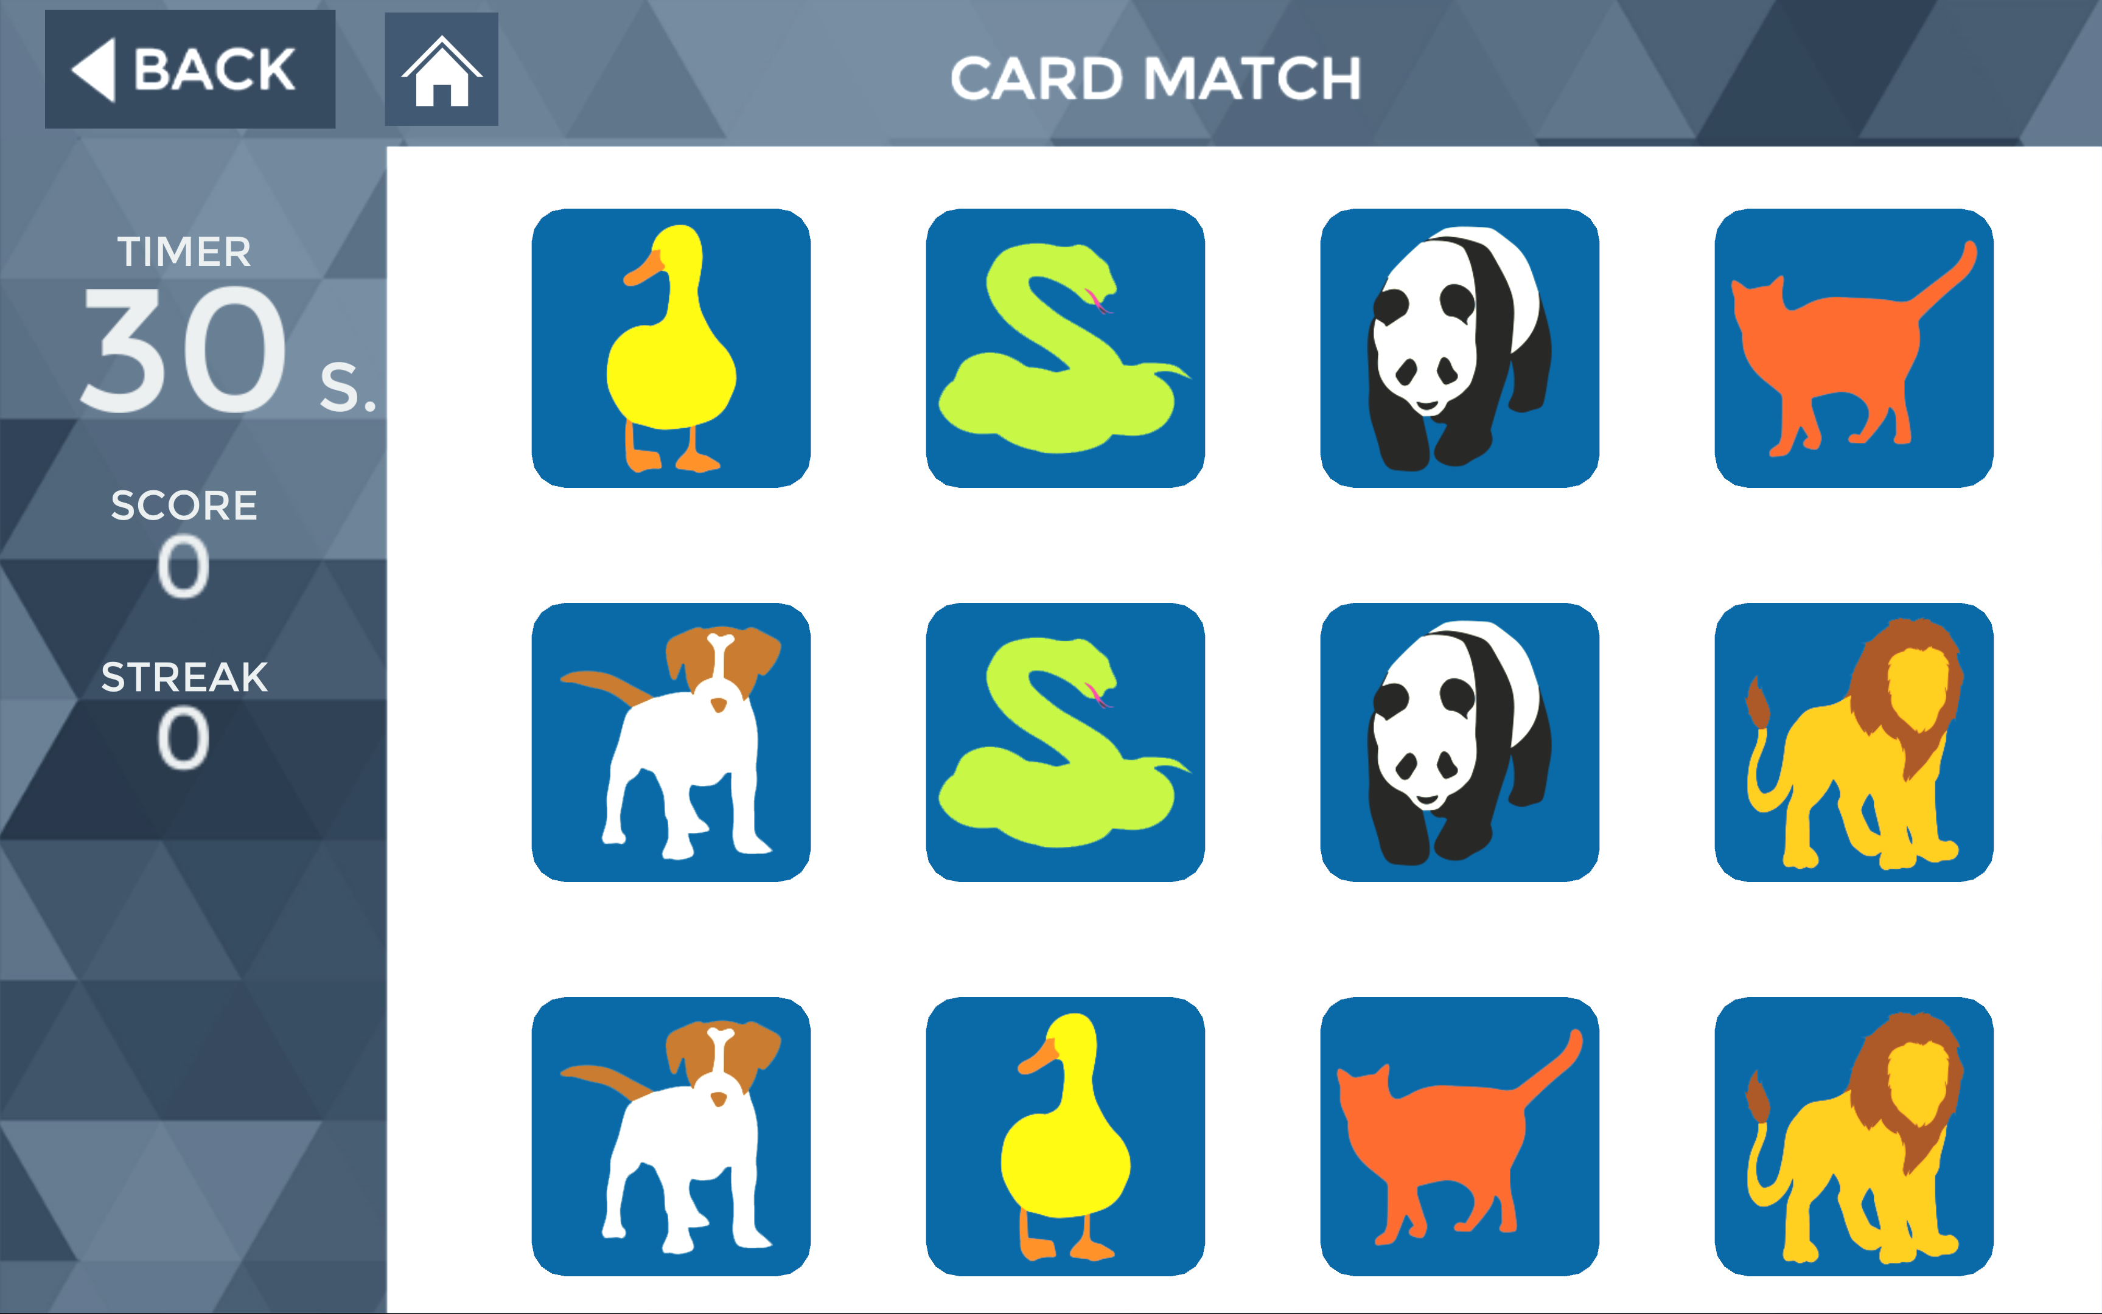
Card Match
Areas Trained
Memory
Object recognition
Speed of processing

Slide 5
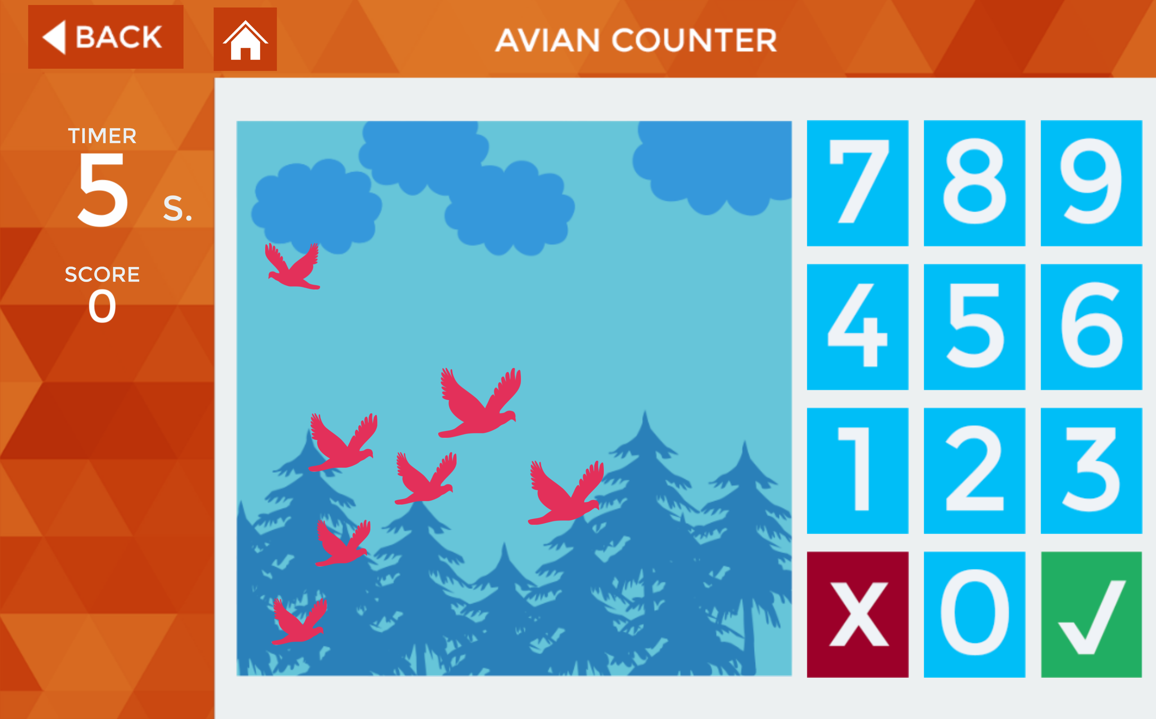
Avian Counter
Area Trained
Memory

Slide 6
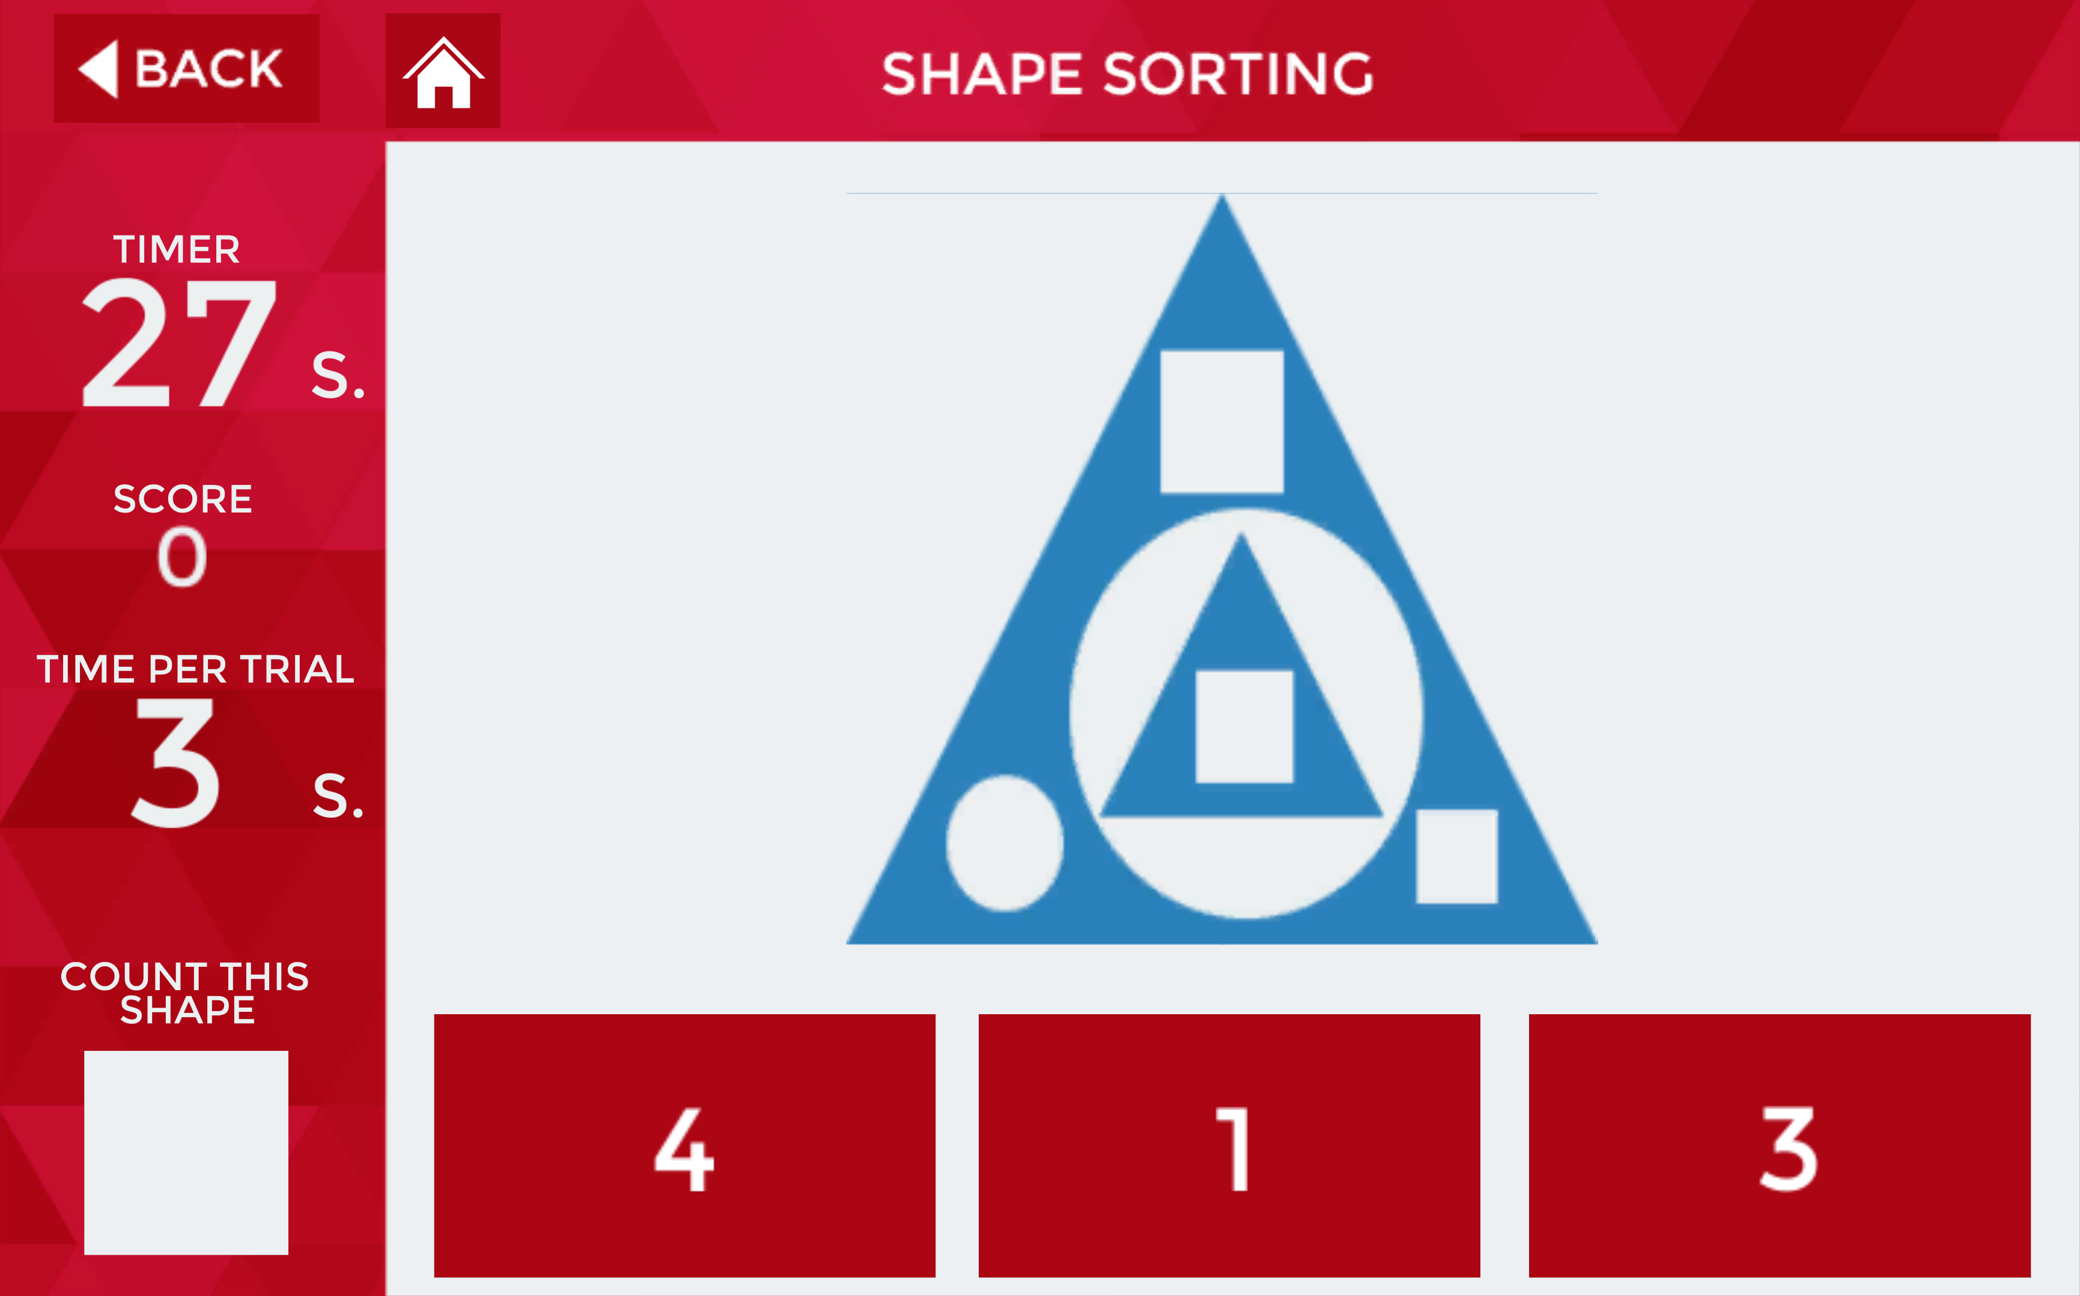
Shape Sorting
Areas Trained
Shape recognition
Speed of processing

Slide 7
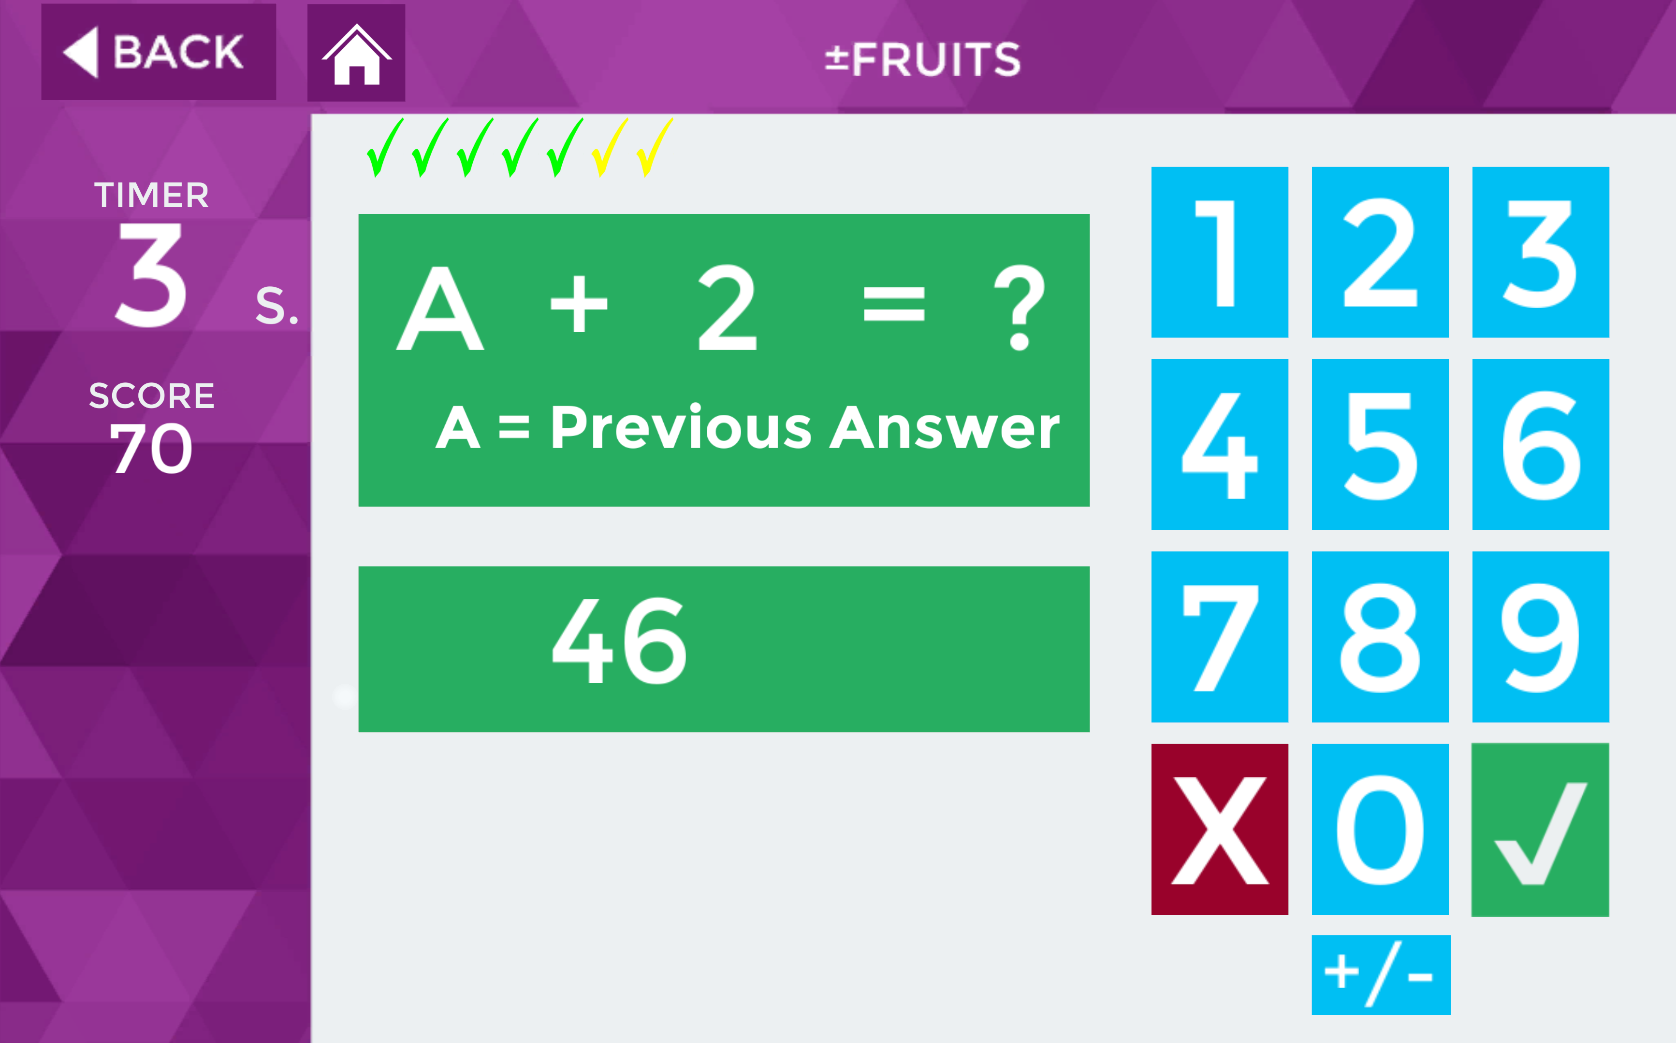
± Fruits
Areas Trained
Arithmetic
Memory
Speed of processing

Slide 8
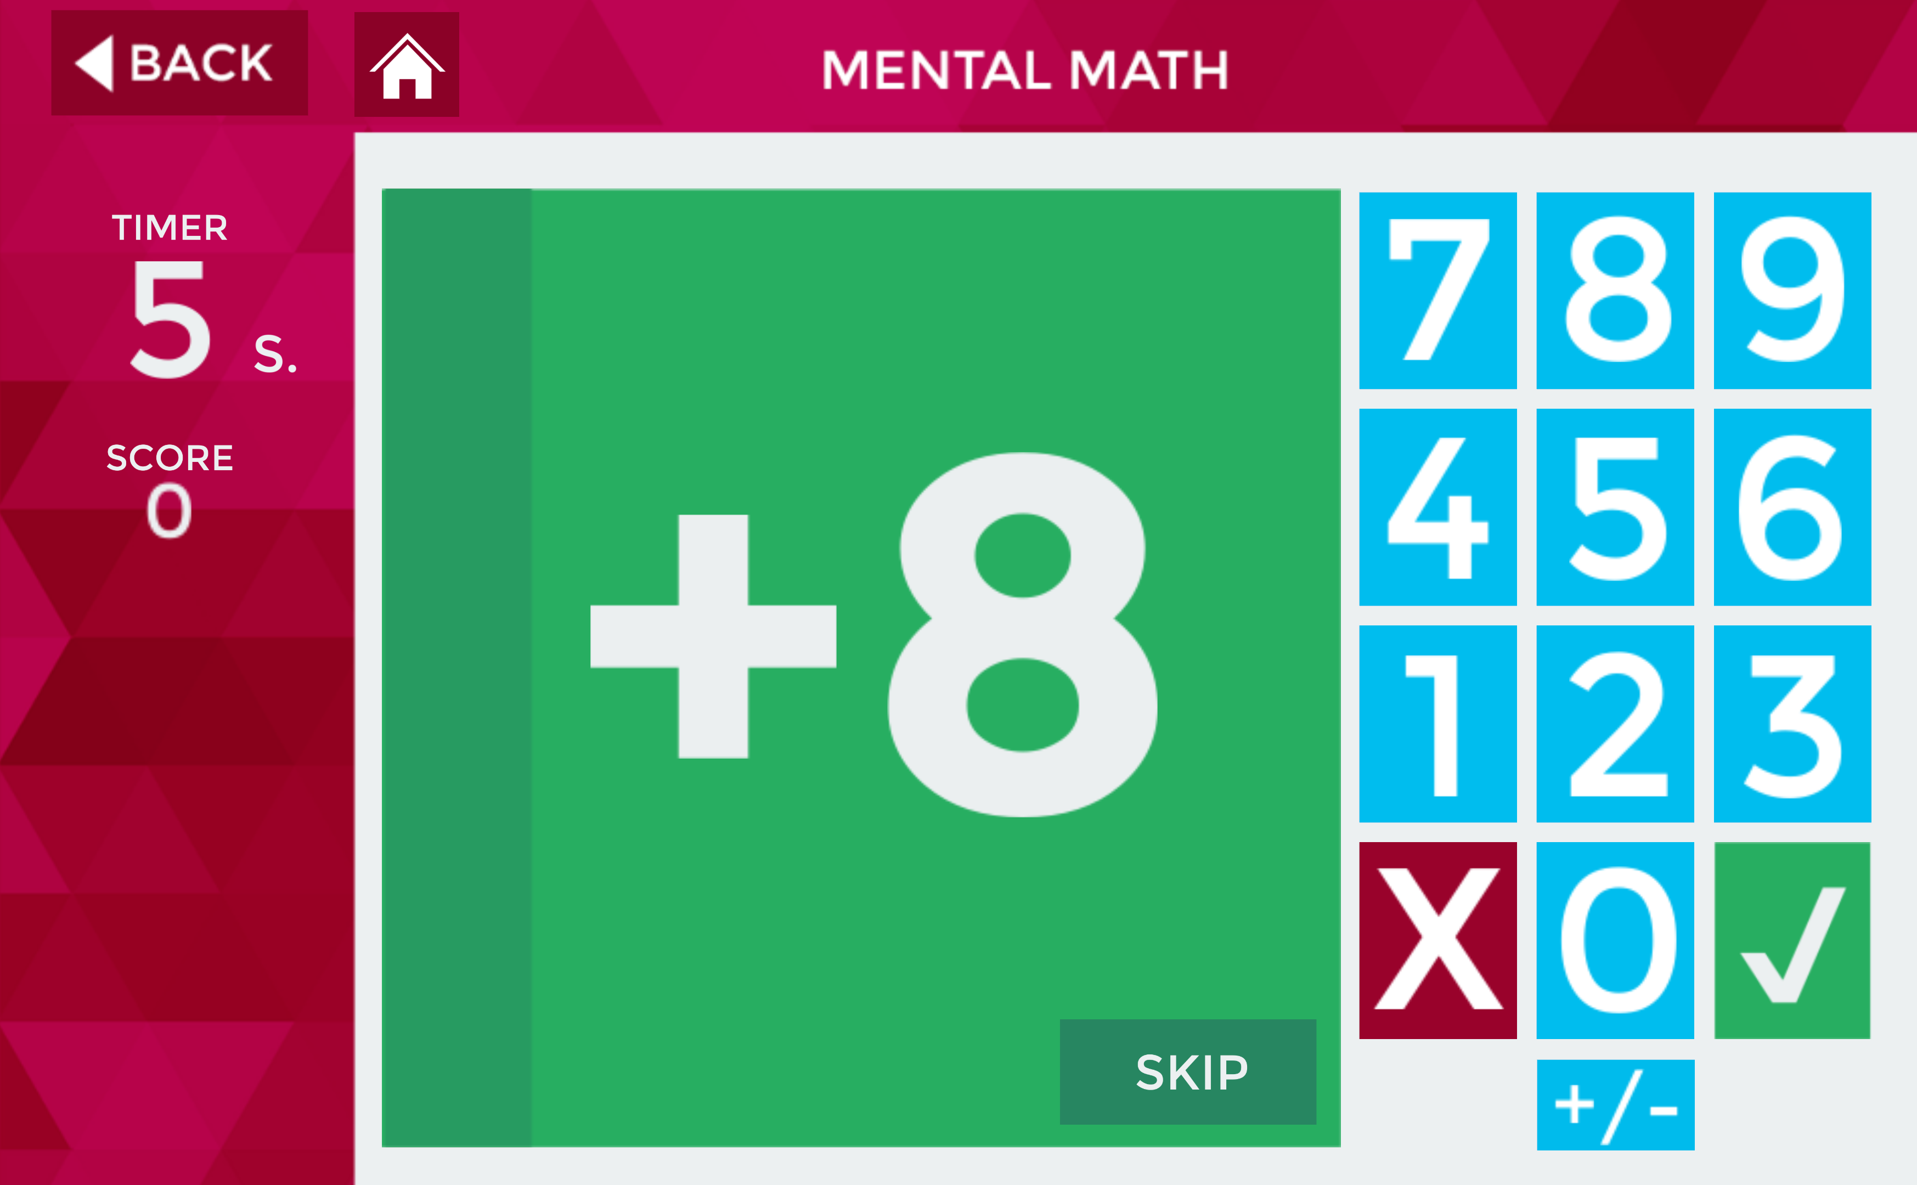
Mental Math
Areas Trained
Memory
Speed of processing
Arithmetic

Slide 9
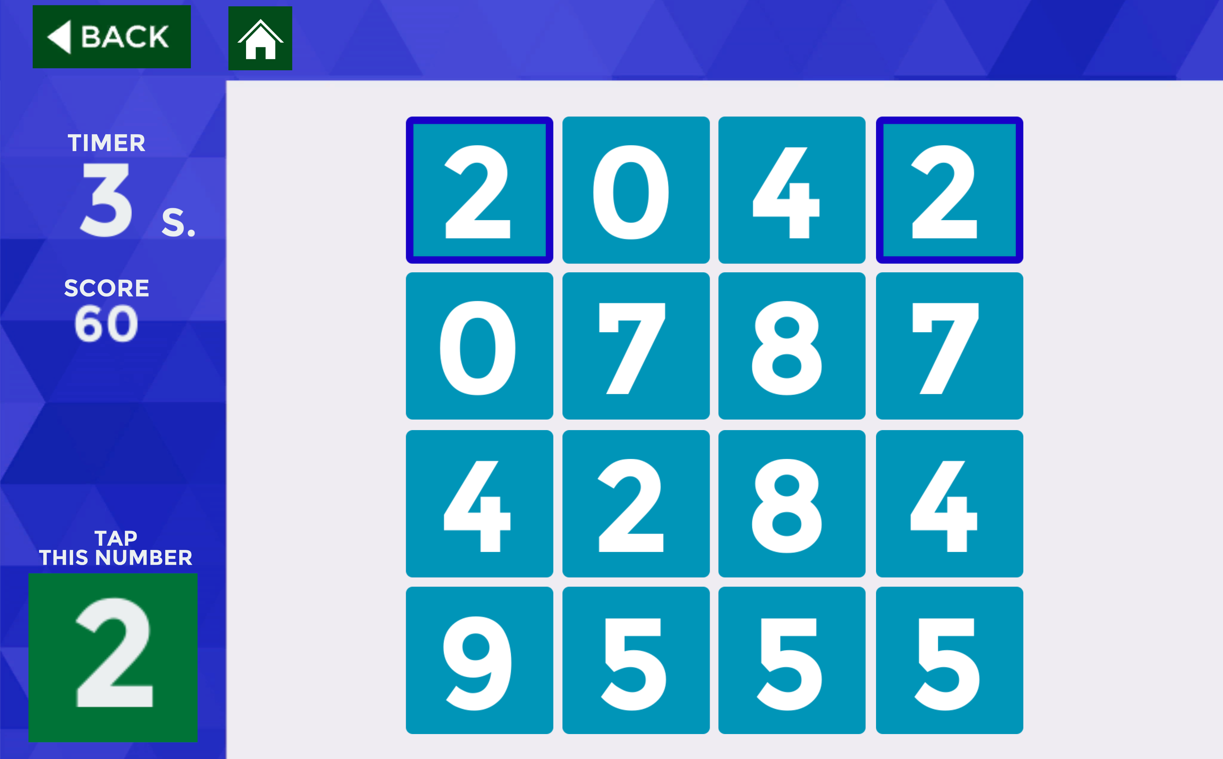
Number Tapper
Areas Trained
Number recognition
Speed of processing

Slide 10
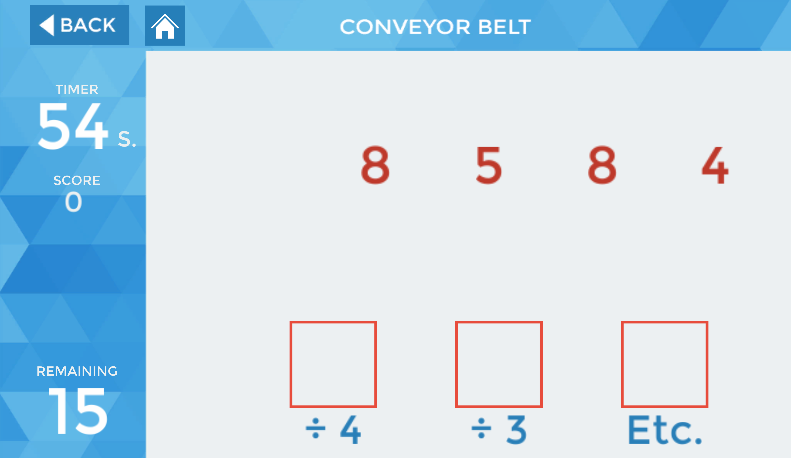
Conveyer Belt
Areas Trained
Speed of processing
Arithmetic

Slide 11
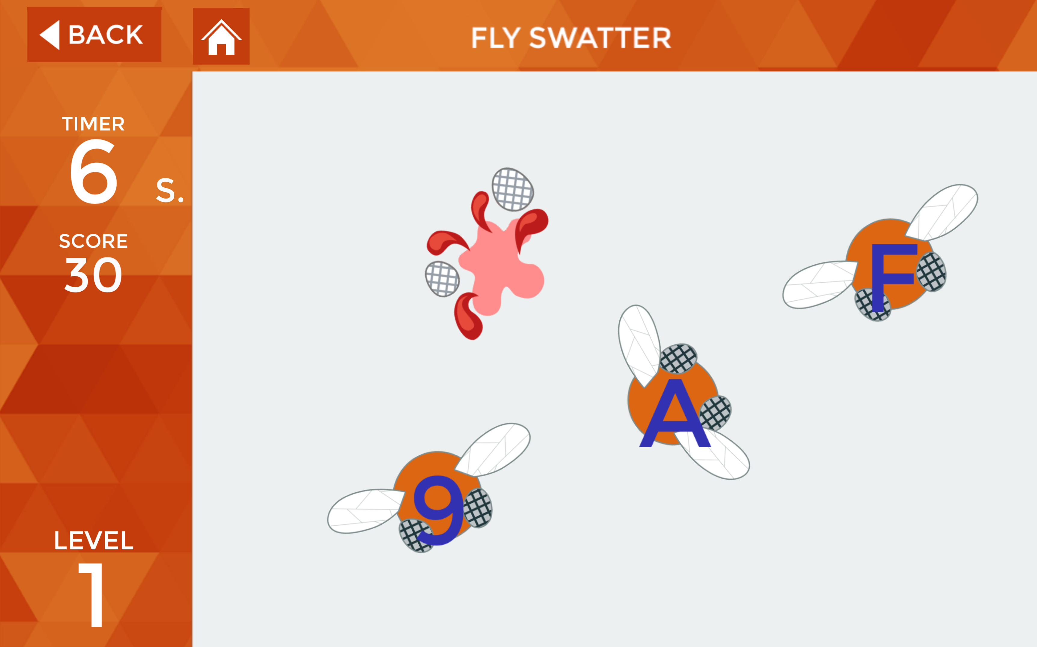
Flyswatter
Areas Trained
Number recognition
Alphabet recognition
Memory
Speed of processing

Slide 12
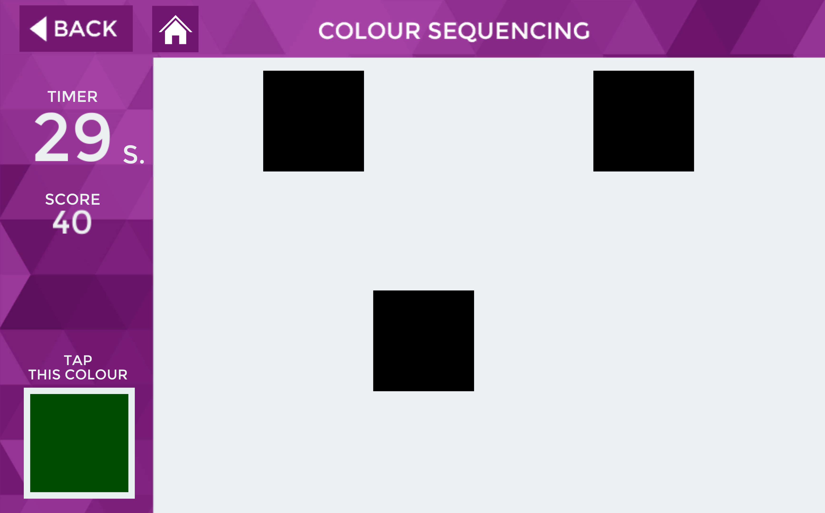
Colour Sequencing
Areas Trained
Memory
Colour recognition

Slide 13
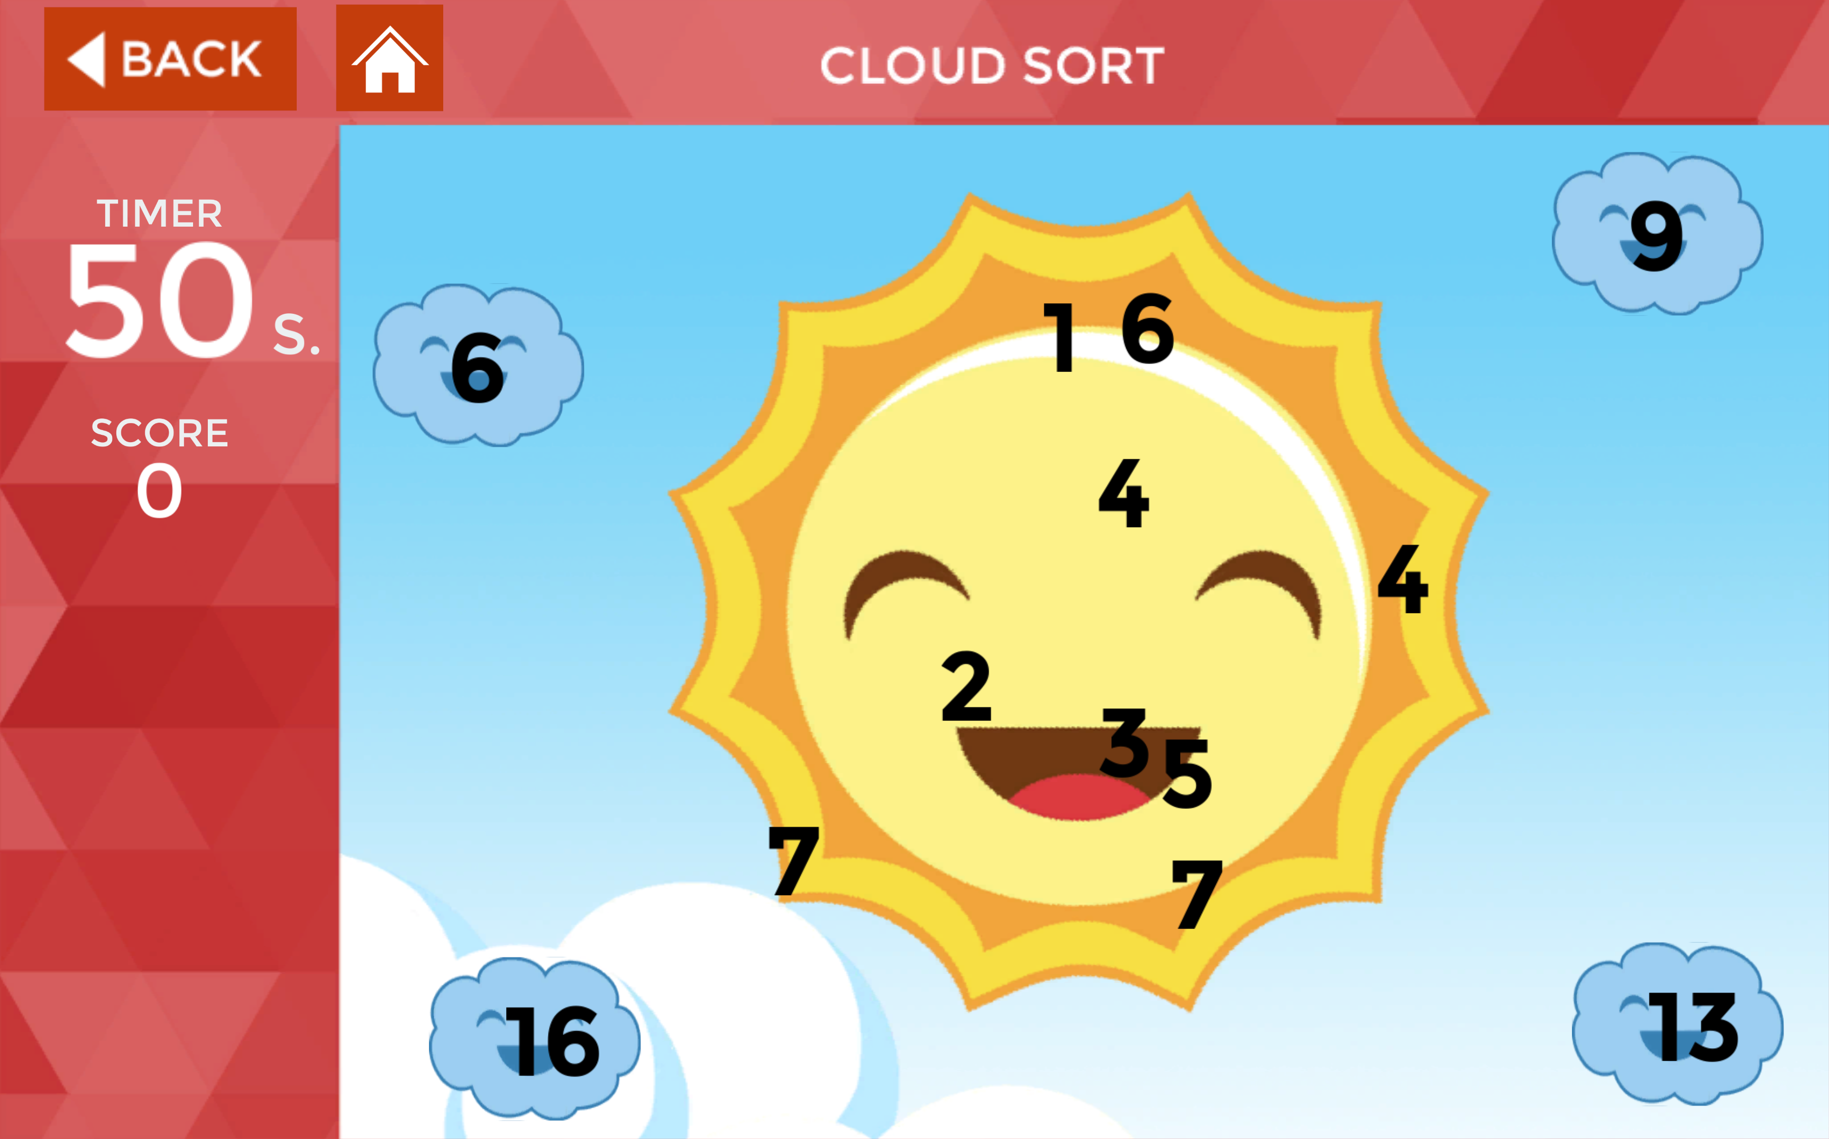
Cloud SOrt
Areas Trained
Arithmetic
Speed of processing

Slide 14
Commercial Viability
Singapore suffers from aging population
With a greater number of elders in the community, the occurrence of dementia is likely to also increase
Research has shown that cognitive simulation can delay or even prevent the onset of dementia
It can also help those suffering from dementia by helping to relieve the symptoms of dementia

Slide 15
Potential opportunities
Other countries suffering from aging population
Japan
Germany
France
Nursing homes or hospitals
Families with elders to care for

Slide 16
Thank you for your kind attention
Are there any questions?

